Slide 1

Internet of Things in Transportation and Logistics

Slide 2
INTRODUCTION
NAME: MOHAMED MIGDHADH
STUDENT ID: S2200065 (VILLA COLLEGE) | 22023480 (UWE)
MODULE CODE: UFCFVK-15-2 _Jan 2023
MODULE TITLE: INTERNET OF THINGS

Slide 3
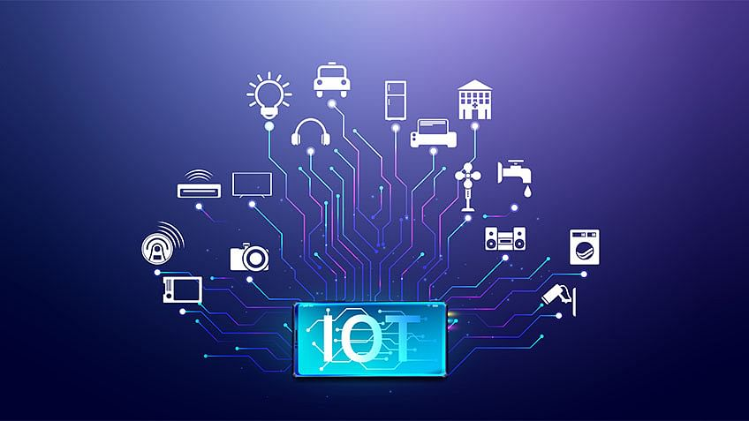
What is Internet of Things?
Internet of Things refers to a network of embedded systems that use machine-to-machine communication to relay information and exchange data between one another through the internet.
Examples of IoT devices:
Light switch
Industrial equipment
Smart lock
Smart phone
Smart watch
Smart car

Slide 4
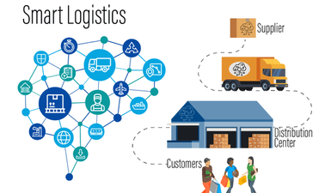
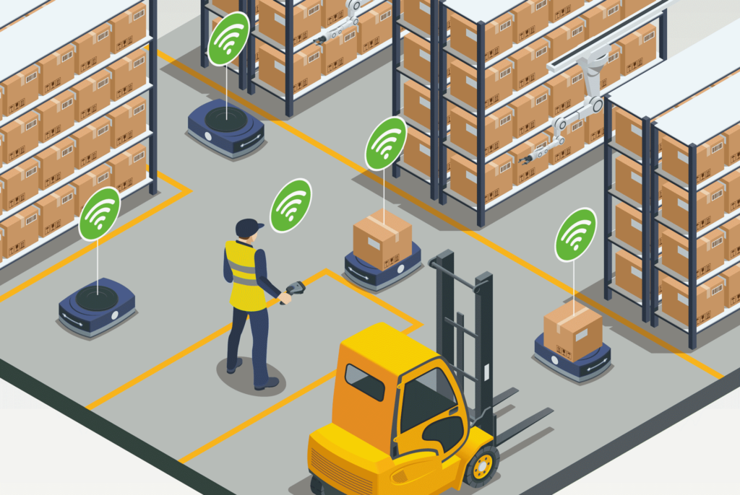
What is Smart Logistics?
It is a concept of modern integrated logistics system
It uses real-time processing and analysis of information
It is able to do self-adjustments as needed

Slide 5
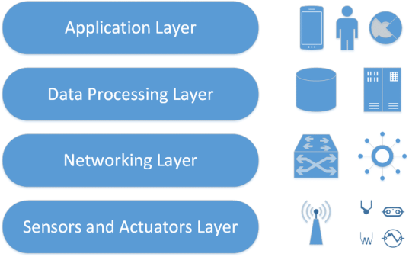
IoT Architecture for Smart Logistics
It consist of 4 main layers, the sensing layer, the network layer, the processing layer and the application layer.
Sensing layer uses advanced sensors to collect various physical data such as logos, audio, video etc.
Network layer consists of infrastructures for communication and networking used to deliver the data collected from the sensing layer to the higher layers
Processing layer uses hardware platforms and intelligent algorithms to access, store and process the data
Application layer, provides the smart logistic services to IoT users.

Slide 6
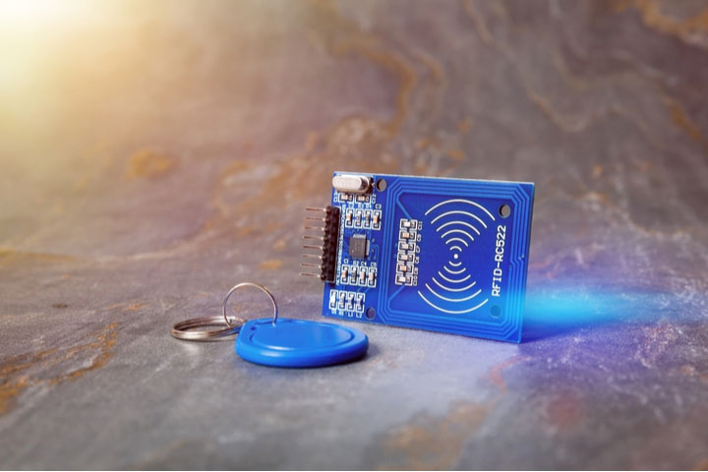
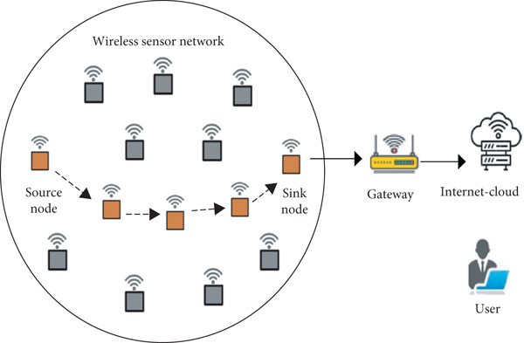
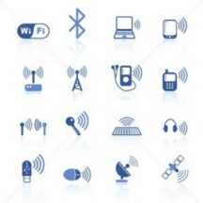
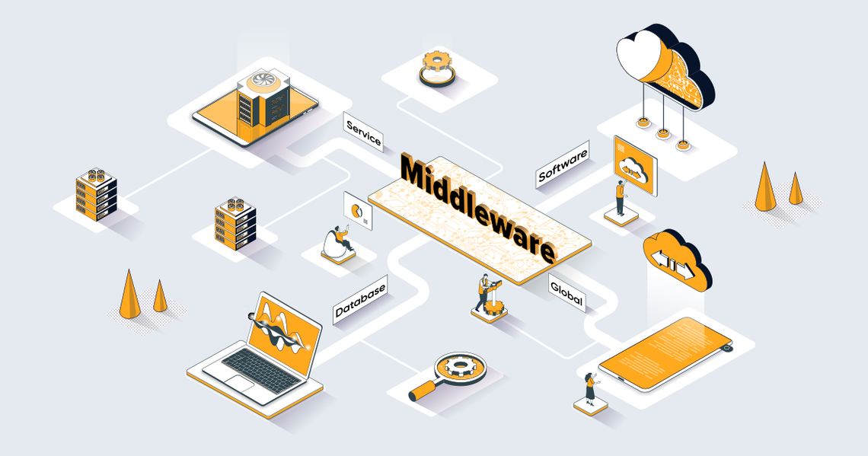
IoT Technologies and their Purposes in Logistics and Transportation.
Radio Frequency Identification (RFID)
Wireless Sensor Networks (WSNs)
Wireless Communication Technologies
Middleware

Slide 7
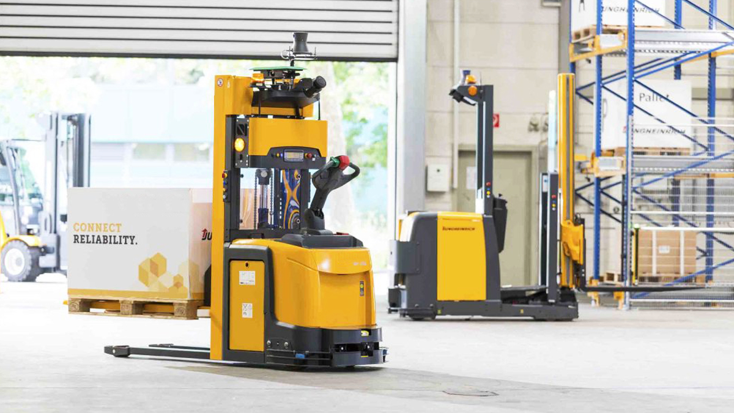
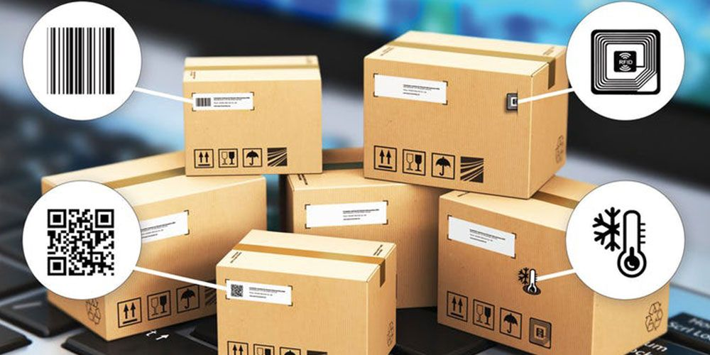
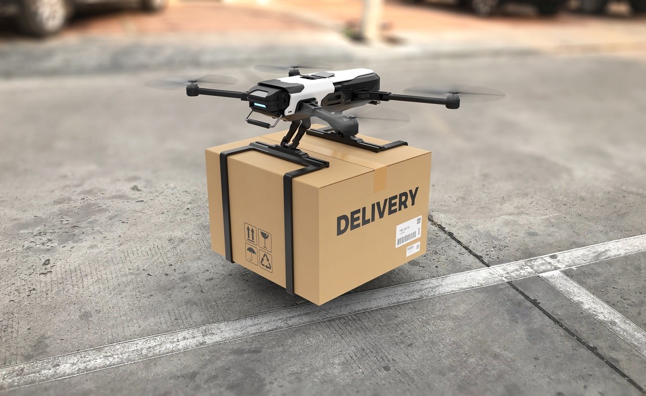

Applications of Smart Logistics
Smart Logistics Transportation.
Smart Warehousing.
Smart Loading/Unloading.
Smart Carrying.
Smart Packaging.
Smart Distribution.
Smart Information Processing.

Slide 8


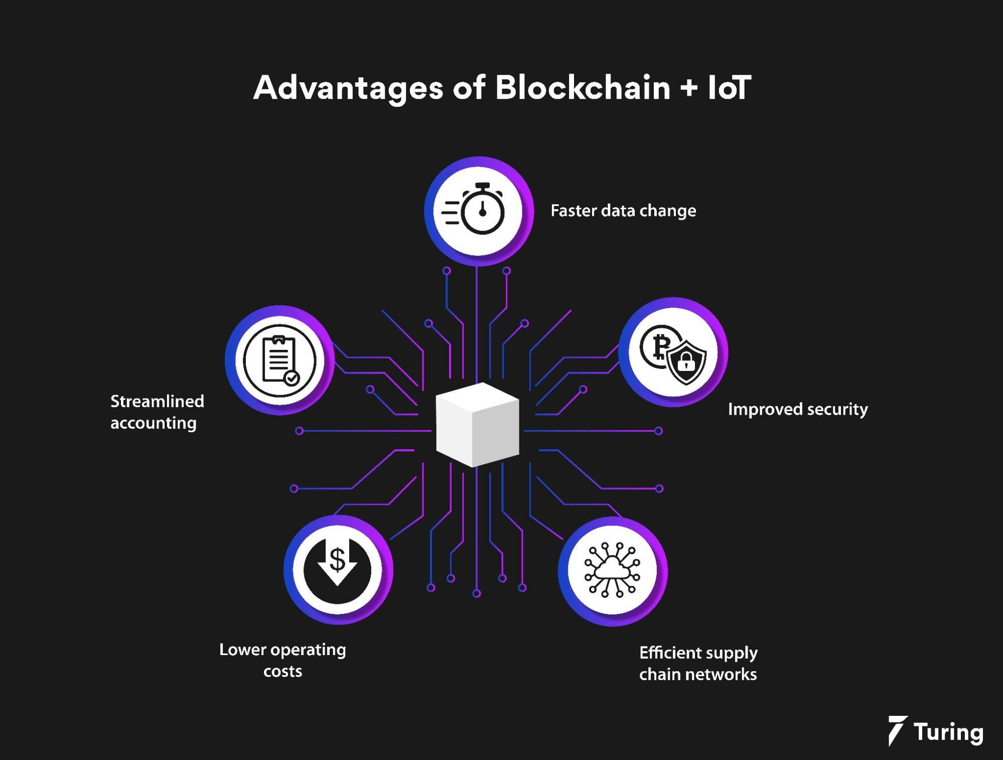
Current Challenges
Privacy and Security.
Standardization.
Resource Management.
Solution to the Challenges
Using block chain technology along with IoT.
Establish appropriate regulations that service providers have to regardless of the location or place of operation of the data controller.

Slide 9
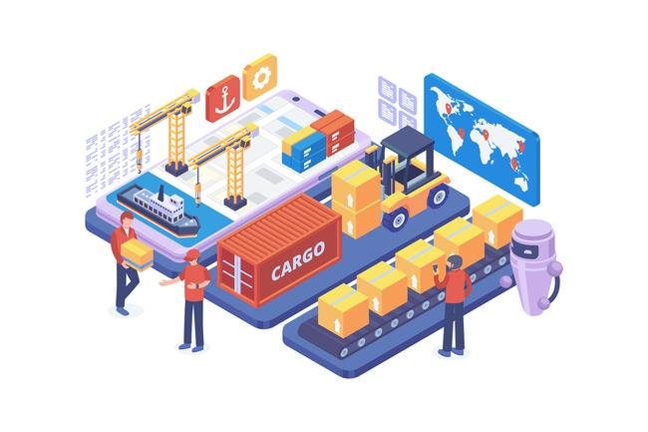

Future Directions
IoT and AI Technologies working together to improve current logistics operations systems.
AI technologies, IoT, big data and cloud computing can be used together to further improve smart warehouse management.
Cloud computing can allow users to have access to the stock available in the warehouse in real time.
AI robots and automatons can be used for loading and unloading of goods and in unmanned transportation and distribution.
AI based Speech recognition programs can be used to build customer service agents.

Slide 10
Thank YOU

